Slide 1
Learning and Intro to Neural Nets
Softmax in Output
Minimization Techniques
Deep Learning
Convolution, Pooling, and Auto-encoding
Conclusion

Slide 2
Dealing with Output
Single continuous output node
(“regression”)
Multiple output nodes—usually for comparison
Problem: differing scale e.g., 229, 0.03, 99, -1000
Solution: softmax function is output shown.
Each between 0 & 1; all sum to 1
e.g., replace 229 by e²²⁹ / [e²²⁹ + e^{0.03} + e⁹⁹ + e⁻¹⁰⁰⁰]
Notes:
When the output to a neural net is a single continuously varying node value, this is often referred to as regression.
When the output consists of multiple nodes, the problem is usually one of classification, such as distinguishing hand drawings of digits 1, 2, 3, and 4. Without some sort of normalization, these can be hard to distinguish—for example, output of 229, 0.03, 99, and -1000.
This is often dealt with using the softmax process, which replaces the outputs {o1, o2, …, on} with
{e^{o1}/[e^{o1} + e^{o2} + … +e^{on}], e^{o2}/[e^{o1} + e^{o2} + … +e^{on}], …, e^{on}/[e^{o1} + e^{o2} + … +e^{on}]}
The advantage of this is that the amount are between 0 and 1, and they sum to 1.

Slide 3
Softmax Example
Given -2, 3, and 8
Softmax is:
0.000047
0.006694 and
0.993259
Notes:
Softmax retains relative magnitudes while placing the values in a comparable framework. Its use is actualy a departure from normal neural net forms in that the computation at a node depends on the values of peers (i.e., not just predecessors). However, this is usually not a problem when applied only to output nodes.

Slide 4
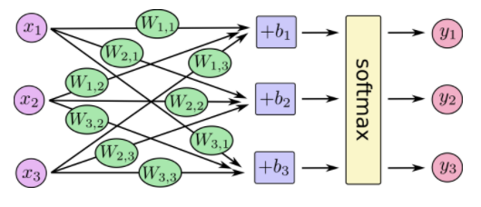
Softmax Usage
784
x‘s
10 output
nodes
https://www.tensorflow.org/get_started/mnist/beginners
Notes:
The figure shows one way to depict softmax.

Slide 5
Usage in TensorFlow
W1 = tf.Variable(tf.zeros([784, 10])) b = tf.Variable(tf.zeros([10])) x = tf.placeholder(tf.float32, [None, 784]) y = tf.nn.softmax(tf.matmul(x, W1) + b)
https://www.tensorflow.org/get_started/mnist/beginners
Notes:
TensorFlow has a built-in function for this.

Slide 6
Softmax Usage in TensorFlow
W1 = tf.Variable(tf.zeros([784, 10])) b = tf.Variable(tf.zeros([10])) x = tf.placeholder(tf.float32, [None, 784]) y = tf.nn.softmax(tf.matmul(x, W1) + b)
softmax
784
10
W1
x
Notes:
The TensorFlow softmax function operates on a rank 1 tensor.

Slide 7
Learning and Intro to Neural Nets
Softmax in Output
Minimization Techniques
Deep Learning
Convolution, Pooling, and Auto-encoding
Conclusion

Slide 8
Batch Gradient Descent
Errors for all training pairs added:
e = ∑ e_{p}
over all training pairs p
Relative to each w_{ij} ,
∂e/ ∂w_{ij} = ∑ ∂e_{p}/ ∂w_{ij}
Notes:
In batch gradient descent (BGD), the errors for all training pairs are summed. It is this sum that we want close to zero. Its rate of change is the sum of the derivatives, which we obtained in the last section.

Slide 9
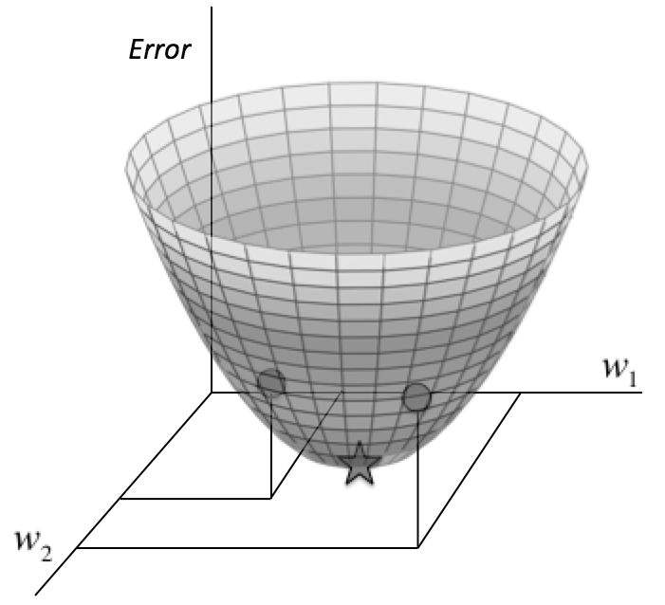
Batch Gradient Descent
From “Fundamentals of Deep Learning: Designing Next-Generation Machine Intelligence Algorithms” by Nikhil Buduma Buduma p19
Notes:
The figure visualizes error as a function of two weights. In this simple example, there is a clear error zero for a particular weight combination (the star). The issue is how to get there.

Slide 10
Best Proportional Change
-0.2 feet per horizontal foot
-0.3 feet per horizontal foot
Notes:
The objective is to determine what direction to step with the steepest decline. The determination is local to the point you are at, so you might as well assume that the surface you are on is a plane. Assume that the plane slopes downward somewhat in both directions. You can visualize this by drawing two lines at right angles on cardboard and sloping it down a bit. Neither of the two directions necessarily has the greatest slope.

Slide 11
Notes:
The two derivatives can be thought of as two orthogonal arrows in the tangent plane.

Slide 12
Batch Gradient Descent
-0.2 feet per horizontal foot
-0.3 feet per horizontal foot
Notes:
Continuing the cardboard analogy, you may be able to see, by holding a piece of cardboard with two arrows drawn on at right angles, that the steepest direction is that of the dashed line—the hypotenuse. In other words, proceeding in the ratio -0.3 : -0.2 (3:2) for first weight / second weight. (You can actually see this immediately when one of these numbers is 0.)
To recap, the process of adjusting the weights (in proportion) where the error is the sum of all training pair errors is called batch gradient descent.

Slide 13
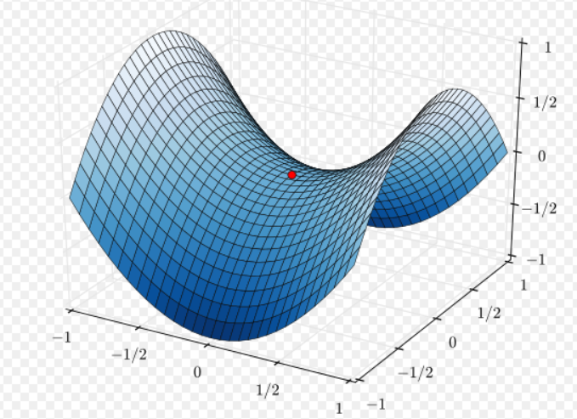
Problem with Batch GD
Following a hill downward often leads to saddle points.
https://en.wikipedia.org/wiki/Saddle_point#/media/File:Saddle_point.svg
Notes:
Going downhill from a point towards zero derivative looks promising but there are two problems.
The first is that one may hit a local minimum. In other words, a value for (w₁, w₂) where the derivatives are zero—locally minimal—but where values for (w₁, w₂) exist with a lower (perhaps much lower) error. Now, the error is supposed to be zero or very close, so this would occur when the process converges on a error not close to zero (“stuck in a local min”) or an error that is small but which leaves open the possibility of a smaller error.
The other possibility is that the derivatives are zero—or very close—due to a saddle point, as shown in the figure. In fact, when there are 4 weights (for example) and zero derivative relative to each one, then only 1 out of 16 combinations is a minimum in every principal direction. The rest are saddle points! In short, an all-zero-derivative point is most likely to be a saddle point rather than a minimum.

Slide 14
The Problem is Potentially Severe ..
The weight (“parameter”) space is hundreds-dimensional!
Notes:
It is impossible to visualize 100-dimensional space but one expects (hopes?) that intuition from 2-D carries over.

Slide 15
The Other Extreme: Stochastic Gradient Descent
e
Functions of a single variable
much easier to handle
w_{ij}
Notes:
Stochastic Gradient Descent (SGD) computes the gradient for a single weight, adjusts the weight, and then repeats for the next weight. This is theoretically slower than BGD but allows more flexibility in finding minima. In practice, it is easier to avoid saddle points.

Slide 16
Compromise: Minibatch Gradient Descent
Proceed by small subsets of the weights.
--often the default.
In TensorFlow:
Controlled by batch parameter
Notes:
A technique that avoids the opaqueness of BGD and the slowness of SGD is minibatch gradient descent. It is so commonly used that it is often called “stochastic gradient descent.”
It is hard to speak in general terms about all neural nets but a number of theoretical results suggest that local minima often occur remarkably close to absolute minima, and that the finding the latter is not as much of a problem as may be feared.

Slide 17
Other Approaches
Momentum slows the pace at which learning takes place
Second order gradients (second derivatives) can detect saddle points
But add complication

Slide 18
Learning and Intro to Neural Nets
Softmax in Output
Minimization Techniques
Deep Learning
Convolution, Pooling, and Auto-encoding
Conclusion

Slide 19
Historically:Increasing # Levels Hardly Helped
Notes:
Since neural nets seemed to show promise, it was believed a long time ago that increasing the number of levels (two in this figure) would make them increasingly useful. But this yielded few new results until the first decades of the 20th century.

Slide 20
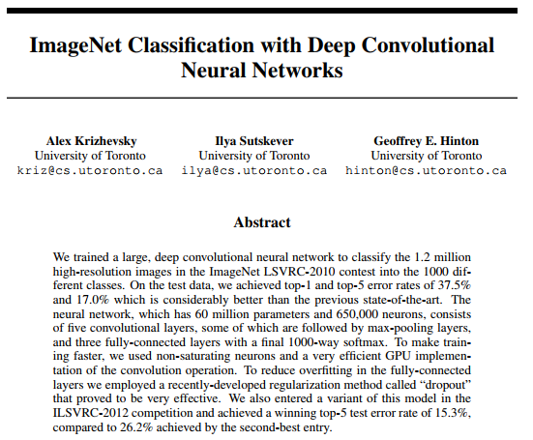
The Classic Paper
Notes:
This changed with the publication of the classic paper in 2012 by Krishevsky et al.

Slide 21
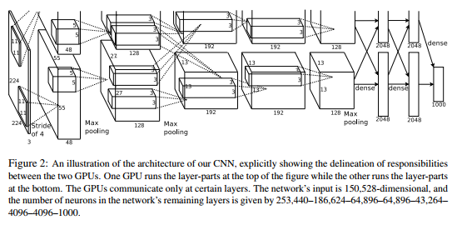
Architecture
Notes:
What brought about the dramatic improvement, and the use of hidden layers are suggested by the figure (from the paper).

Slide 22
Architecture (Expanded Next)
Notes:
What brought about the dramatic improvement, and the use of hidden layers are suggested by the figure (from the paper).

Slide 23
Architecture: Input End
Notes:
What brought about the dramatic improvement, and the use of hidden layers are suggested by the figure (from the paper): specific architectures for the hidden layers.

Slide 24
Architecture: Output End
Notes:
What brought about the dramatic improvement, and the use of hidden layers are suggested by the figure (from the paper).

Slide 25
Reasons for Success of Deep Learning
Purpose for each hidden layer
For images: convolution
Availability of massive amounts of varied data
Use of GPU’s
Notes:
The figure lists what are widely believed to be the reasons that deep learning has finally become successful. Convolution is a way of rationally summarizing visual data with acceptable loss. It was also discovered that some processes which seemed to be going nowhere did, in fact, start to converge much later than originally thought.

Slide 26
Learning and Intro to Neural Nets
Softmax in Output
Minimization Techniques
Deep Learning
Convolution, Pooling, and Auto-encoding
Conclusion

Slide 27
Image Processing Introduction
…
0
1
1
0
0
…
Notes:
Encoding like that shown in the figure can work—because training and execution work from the same encoding—but this encoding loses proximity information.

Slide 28
Without Convolution
Notes:
The figure shows image input processing where the proximity information of input points is lost.

Slide 29
With Convolution
Notes:
With convolution, proximity information of input points is retained.
But convolution is a more general concept, where connectivity is reduced.

Slide 30
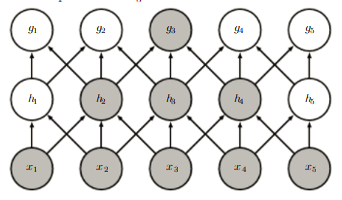
Depth Allows Eventual Integration
From “Deep Learning” by Goodfellow et al http://www.deeplearningbook.org/contents/convnets.html
Notes:
As the figure shows, lateral relationships can be captured even without full connectivity—by increasing the depth (i.e., by introducing enough layers).

Slide 31
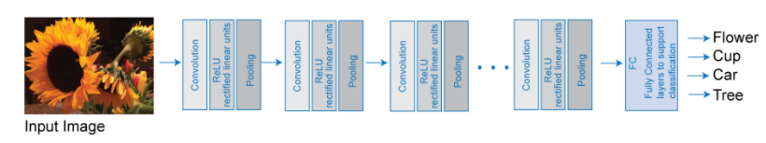
Convolution (Expanded Next)
https://www.mathworks.com/help/nnet/ug/introduction-to-convolutional-neural-networks.html?s_tid=gn_loc_drop
Notes:
Convolution for image recognition is thus mainly the process of replacing pixel-by-pixel input with sub-region input, typically in a cascading form as shown, where the learning gets increasingly generalized (e.g., “diagonal bright streak” → “petal form”). The idea of convolution is to preserve the 2D proximity of input, and thus give the neural net more of a start.
After the convolution, additional convolution or more conventional means are used.
Image processing is not the only context in which proximity of input nodes matters, so convolution is applicable for a wider set of applications.

Slide 32
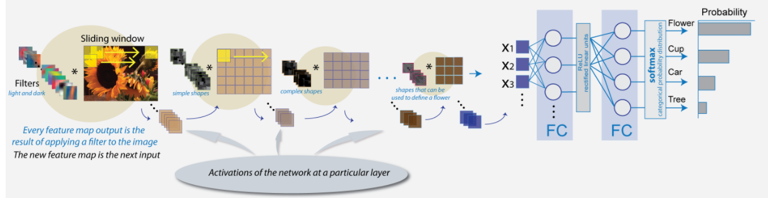
CNN Deep Learning: More Detail
https://www.mathworks.com/help/nnet/ug/introduction-to-convolutional-neural-networks.html?s_tid=gn_loc_drop
Notes:
This figure shows the full net in this example. Various schemes for compressing sub-images can be employed. These can be further factored by pre-made filters. The trade-off is better results but slower training times.

Slide 33
CNN Deep Learning: Input End
https://www.mathworks.com/help/nnet/ug/introduction-to-convolutional-neural-networks.html?s_tid=gn_loc_drop
Notes:
This figure shows multiple convolutions.

Slide 34
CNN Deep Learning: Output End
https://www.mathworks.com/help/nnet/ug/introduction-to-convolutional-neural-networks.html?s_tid=gn_loc_drop
Notes:
This figure shows the last part of the net, which is conventional.

Slide 35
Pooling
After obtaining our convolved features as described earlier, we decide the size of the region, say m×n to pool our convolved features over.
Divide our convolved features into disjoint m×n regions, and take the mean (or maximum) feature activation over these regions to obtain the pooled convolved features. These pooled features can then be used for classification.
Adapted from http://ufldl.stanford.edu/tutorial/supervised/Pooling/
Notes:
In identifying hidden layers, once may employ pooling, in which the activation (transfer function) takes averages—or some other summarizing number. This reduces training time, perhaps without too much compromise.

Slide 36
AutoEncoders
a
b
c
“Learning” is a kind of compression.
a
b
c
Notes:
An issue in adding layers is to ensure that they do indeed learn something. “Learning” is a kind of compression. For example, we can learn from multiple statements like “Douglas is a dog”, “David is a dog”, “Caitlin is a cat”, “Dillon is a dog” etc. that “Animals with D-names around here are probably dogs.” This compresses multiple statements into one.
A single layer with dimension reduction obviously learns but it is not obvious that additional layers learn more. A clever way to ensure compression (learning) is by means of encoders. The output to an encoder is the same as its input. This is in effect a separate neural net trained to compress the input data. Once it has learned, only the lower half is used, and the weights are kept constant.

Slide 37
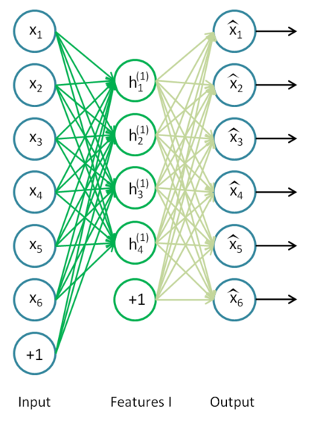
Using AutoEncoders to Perform Deep Learning 1
Classifiers
http://ufldl.stanford.edu/wiki/index.php/Stacked_Autoencoders
Notes:
This example from Stanford used an auto-encoder with bias. Compression is from 6 dimensions to 4.

Slide 38
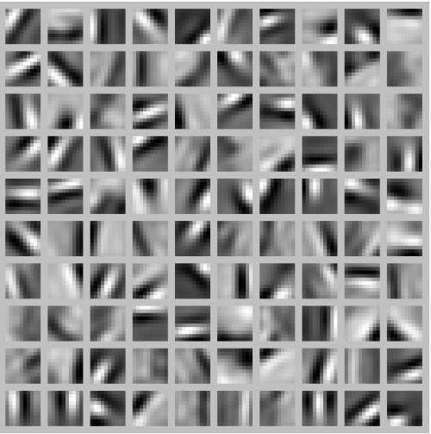
What is Being Learned by These Hidden Nodes?
See “If we have an autoencoder with 100 hidden units (say), then we our visualization will have 100 such images—one per hidden unit. …”
at
http://ufldl.stanford.edu/tutorial/unsupervised/Autoencoders/
Notes:
It is sometimes possible to gauge what is being learned by hidden nodes, especially in image processing—in this case recognizing a kind of pattern. Each of these images is reconstructed from the weights of the connections ending at the hidden node in question. So at the next level, a node can be explained as something like 0.1 of image at (x=1, y=1) plus 0.7 of image at (x=2, y=1), etc.

Slide 39
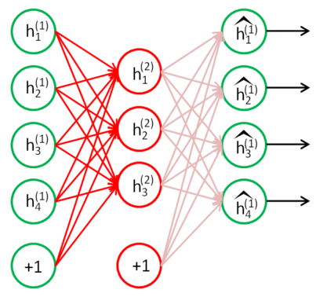
Using AutoEncoders to Perform Deep Learning 2
Classifiers
of classifiers
http://ufldl.stanford.edu/wiki/index.php/Stacked_Autoencoders
Notes:
Auto-encoding is used again in this example to compress from 4 to 3 dimensions.

Slide 40
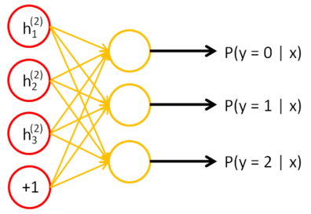
Using AutoEncoders to Perform Deep Learning 3
http://ufldl.stanford.edu/wiki/index.php/Stacked_Autoencoders

Slide 41
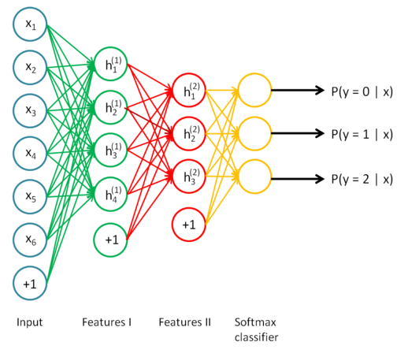
Using AutoEncoders to Perform Deep Learning 4
http://ufldl.stanford.edu/wiki/index.php/Stacked_Autoencoders
Notes:
The two auto-encoders are used in sequence to produce this particular deep learning.

Slide 42
Learning and Intro to Neural Nets
Softmax in Output
Minimization Techniques
Deep Learning
Convolution, Pooling, and Auto-encoding
Conclusion

Slide 43
Business Impact of Neural Nets
Recognizes patterns automatically
Handwriting
Voice recognition
Applications where a math model is unobtainable or impractical
Spotting anomalies, faults or variants from the norm
Must have time to learn

Slide 44
Example Application (Haliburton)
Problem: Examine underground explosions in oil exploration in the presence of noise.
Solution: Filter out noise. Proprietary, but uses a backprop approach.
Adapted from http://www.mathworks.com/tagteam/66189_9847v01_User_Story_Halliburton_2010_final.pdf

Slide 45
TED Talk: Deep Learning Applications
http://www.ted.com/talks/jeremy_howard_the_wonderful_and_terrifying_implications_of_computers_that_can_learn?language=en
Notes:
The URL shows an inspirational talk about machine learning by Jeremy Howard.

